Slide 1
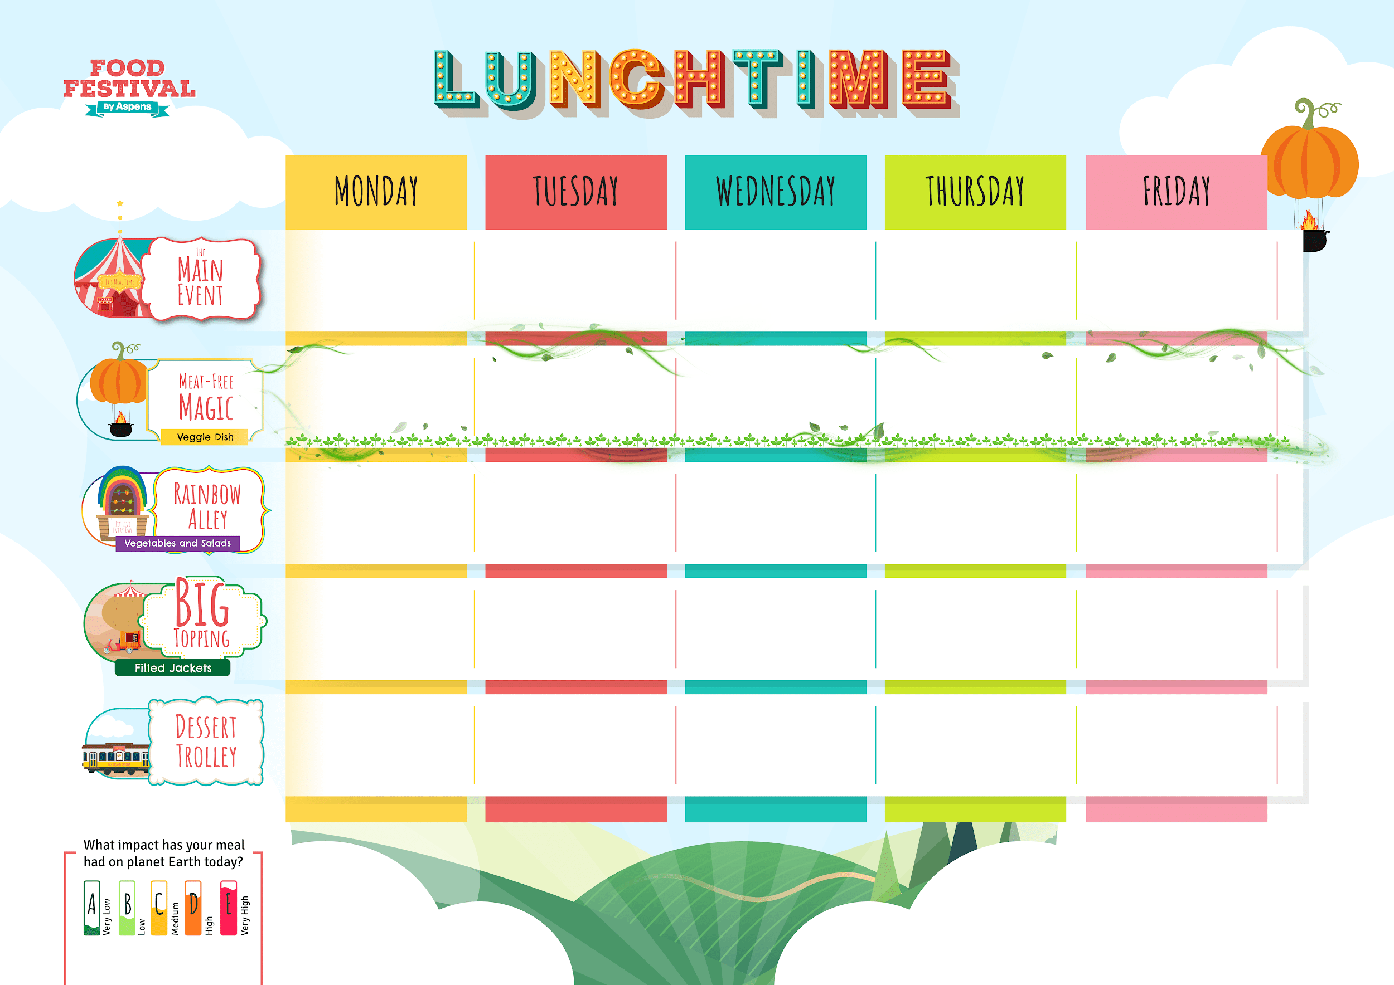












PRIMARY
TRADITIONAL
WEEK 1
Autumn Winter 2025/26
03/11/25, 24/11/25, 15/12/25,
05/01/26, 26/01/26, 16/02/26,
09/03/26, 30/03/26
Cheese and Tomato Pizza Slice
with Wedges
Meatball
Marinara Pasta
Roast Chicken,
Stuffing, Skin on Roasties
and Gravy
Bangers, Wedges
and Gravy
Golden Fish Fingers
or
Salmon Fingers
and Chips
Baked Sweetcorn Fritters
with Wedges
Cheesy Pea Frittata
with Pasta Salad
Roasted Vegetable Strudel,
Skin on Roasties
and Gravy
Cheesy Bean Wrap
with Chips
Veggie Bangers,
Wedges and Gravy
Vegetable Sticks
Mixed Salad
Carrots and Cabbage
Mixed Greens
Peas
Beans,
Cheese or
Tuna Mayo
Beans,
Cheese or
Tuna Mayo
Beans,
Cheese or
Tuna Mayo
Beans,
Cheese or
Tuna Mayo
Beans,
Cheese or
Tuna Mayo
Strawberry and Pineapple Jelly
Butterfly Pastry Biscuits
Banana Bread
and Custard
Apple
Cinnamon Buns
Lemon
Drizzle Cake
Topped Pasta
Daily salad bowl, freshly baked bread, yoghurts and cut fruit
Hot Pasta topped with Homemade Tomato Sauce
& Cheese

Slide 2
PRIMARY
TRADITIONAL
WEEK 2
Autumn Winter 2025/26
,
10/11/25, 01/12/25, 22/12/25,
12/01/26, 02/02/26, 23/02/26,
16/03/26
Vegetable
Lasagne
Creamy Chicken & Sweetcorn Pasta
Roast Chicken,
Stuffing, Skin on Roasties
and Gravy
Mild Chilli Con
Carne with Rice
Golden Fish Fingers
and Chips
Green Veg & Butter Bean Pie
with Wedges
Veggie Whole Grain Pasta Bolognese
Cheddar & Broccoli Crustless Quiche
Vegetable Bean
Chilli with Rice
BBQ Veggie Wrap
with Chips
Sweetcorn
Broccoli
Carrots and Peas
Mixed Greens
Baked Beans
Beans,
Cheese or
Tuna Mayo
Beans,
Cheese or
Tuna Mayo
Beans,
Cheese or
Tuna Mayo
Beans,
Cheese or
Tuna Mayo
Beans,
Cheese or
Tuna Mayo
Chocolate
Popcorn Bars
Orange and
Peach Jelly
Apple Tea Cake
and Custard
Iced Vanilla
Sponge Cake
Carrot Cake
Topped Pasta
Daily salad bowl, freshly baked bread, yoghurts and cut fruit
Hot Pasta topped with Homemade Tomato Sauce
& Cheese

Slide 3
PRIMARY
TRADITIONAL
WEEK 3
Autumn Winter 2025/26
,
17/11/25, 08/12/25, 29/12/25,
19/01/26, 09/02/26, 02/03/26,
23/03/26
Cheese and Tomato Pizza Slice
with Wedges
Lasagne
Roast Chicken,
Stuffing, Skin on Roasties
and Gravy
Chicken &
Sweetcorn Pie
with Wedges
Golden Fish
Fingers
& Chips
Macaroni Cheese
Vegetable
Ratatouille
with Rice
Carrot & Stuffing
Puff Pastry Plait,
Skin on Roasties
with Gravy
Root Vegetable
and Bean Stew
with Wedges
Vegetable Fingers
with Chips
Vegetable Sticks
Sweetcorn
Roasted Roots
Peas
Baked Beans
Beans,
Cheese or
Tuna Mayo
Beans,
Cheese or
Tuna Mayo
Beans,
Cheese or
Tuna Mayo
Beans,
Cheese or
Tuna Mayo
Beans,
Cheese or
Tuna Mayo
Jelly
Sweet Potato Chocolate Brownie
Eve’s Apple
Pudding & Custard
Muesli Bars
Vanilla Cookies
Topped Pasta
Daily salad bowl, freshly baked bread, yoghurts and cut fruit
Hot Pasta topped with Homemade Tomato Sauce
& Cheese

