Slide 1



Galliard Primary School
Year 3 and 4

Slide 2
Meet the team
Ms Begum – AHT, LKS2 Lead
Year 3
Ms Georgiou, Ms Moses, Ms Caliskan
Year 4
Ms Begum, Ms Brown, Ms Rebecca, Mr Robinson
HLTA: Mrs Soteriou

Slide 3




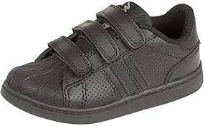









Uniform
Label clothes
Stud earrings
School bags
​

Slide 4







P.E Kits
Label clothes
Stud earrings
Hair tied back
School bags
​

Slide 5

Children have settled in well!

Slide 6
Our core values
School Code of Conduct
Respect
Responsibility
Justice
Courage
Compassion
Integrity
Be kind
Be safe
Be responsible

Slide 7


The school day
8.55
Soft start - doors open at 8:45
3.25 finish

Slide 8

Broad and rich curriculum
Maths
English
Science x2
P.E.
History
Art/DT
French
R.E
Music
Geography
History

Slide 9

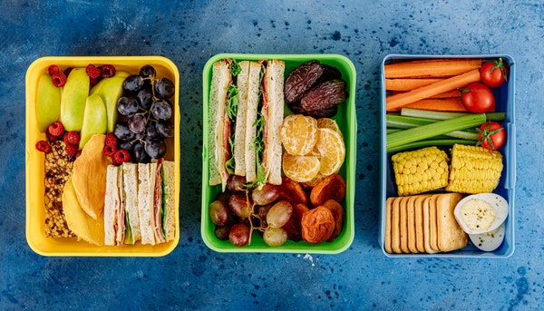
Lunches
Packed lunch or school dinners for the term
No nuts, fizzy drinks, high in sugar foods
Access dinner menus through the school website

Slide 10

Y4 Multiplication Check
Mandatory for all children
3-week window to complete in June
Online, on-screen test
25 questions, 6 seconds per question
Currently multiplication facts only
​

Slide 11

Homework
Maths
Reading
Due following Friday
​

Slide 12


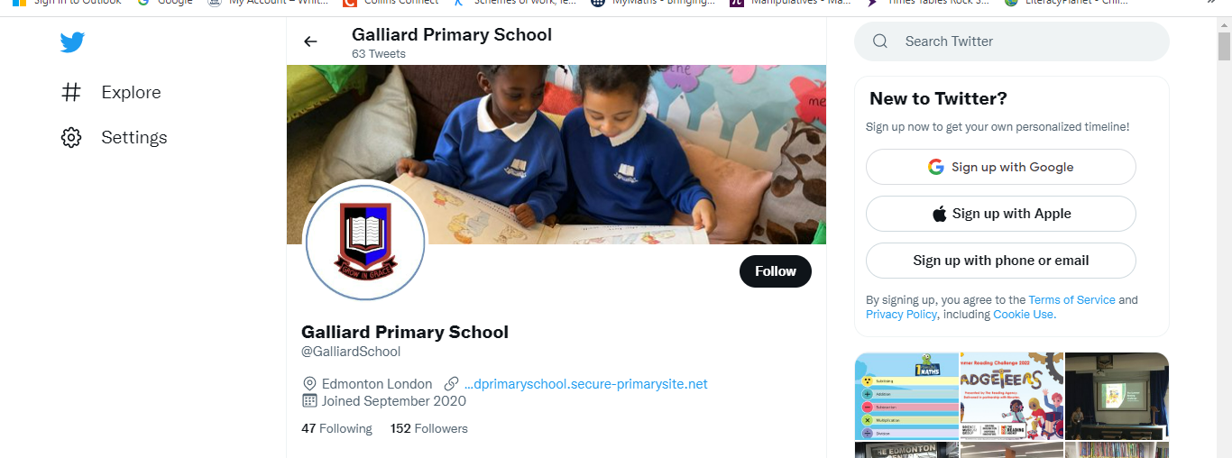
Keep up to date!

Slide 13

Your help matters
A good nights sleep – 8/10 hours
Check homework, check their understanding
Ask about their day
Bring them to school on time
Read with them!
Books are change weekly/when needed

Slide 14

Read, Read, Read
Daily
Read to them, read around them, listen to them read, just read!
Reading records
Make a comment
​

Slide 15


