Slide 1



Schools & Children’s Services
Applying for a Secondary School 2024
Striving for excellence
www.enfield.gov.uk

Slide 2

Types of Schools
Community – the Local Authority (elected Councillors) is responsible for deciding the admission arrangements for pupils
Foundation – the School’s Governing Body is responsible for deciding the admission arrangements for pupils

Slide 3
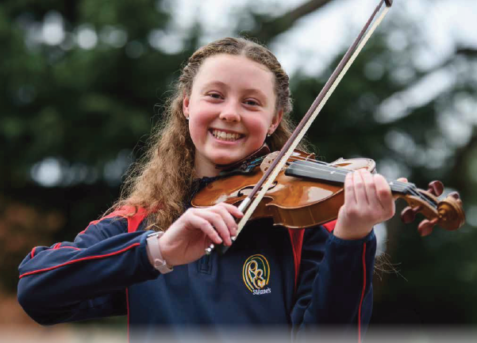
Types of Schools
Voluntary Aided - the School’s Governing Body is responsible for deciding the admission arrangements for pupils
Academies and Free Schools–publicly funded state schools. The Academy Council or School Governors are responsible for deciding the admission arrangements

Slide 4
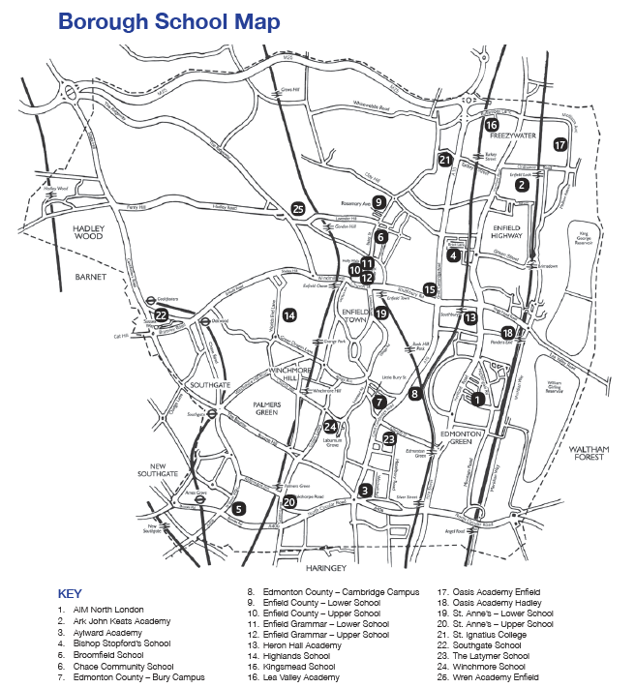
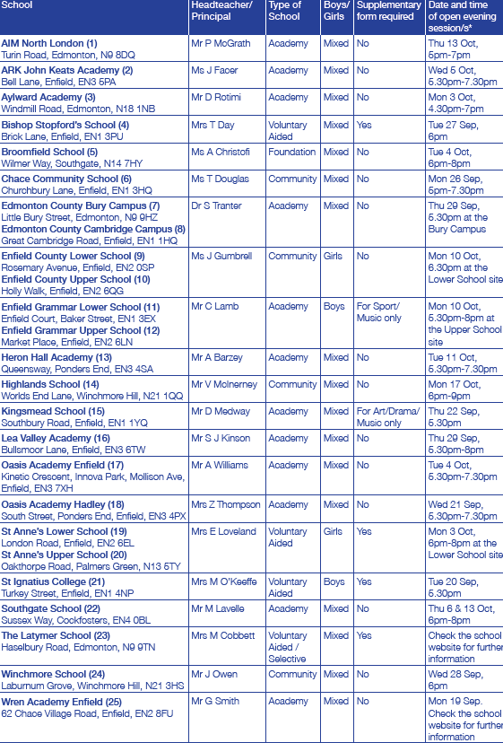
Information Booklet- page 10

Slide 5
Schools in Enfield
AIM North London (A)
Aylward Academy (A)
Broomfield ( F)
Edmonton County (A)
Enfield Grammar (A)
Highlands (C)
Lea Valley Academy (A)
Oasis Academy Hadley (A)
St Ignatius College (VA )
Southgate ( A )
Winchmore ( C )
ARK John Keats (A)
Bishop Stopford’s CE (VA)
Chace Community (C)
Enfield County School for Girls(C)
Heron Hall Academy (A)
Kingsmead (A)
Oasis Academy Enfield (A)
St Anne’s Catholic High School
for Girls ( VA )
The Latymer (VA)
Wren Academy, Enfield (A)

Slide 6

Admission Criteria
Rules used to decide which children are offered places when there are more applications than places available.
Rules may differ between local authorities and types of schools.
Check school and local authority websites in case there are any changes to the information in LA booklets

Slide 7
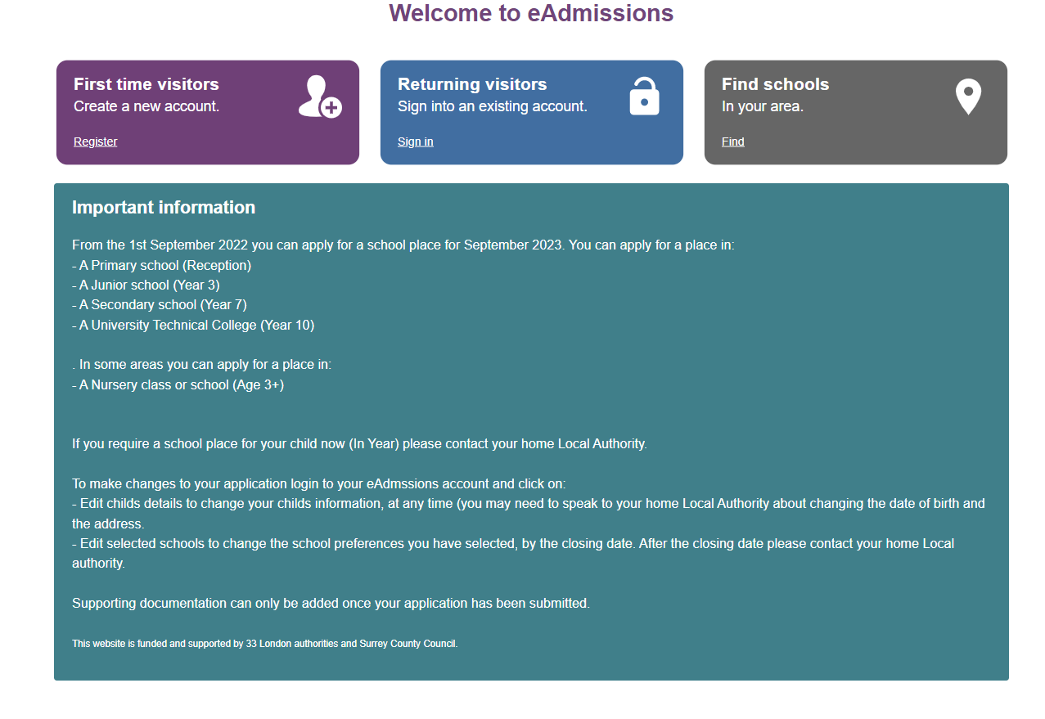
How to apply - www.edmissions.org.uk

Slide 8
On Line Applications
It is quick and easy to do – just register and follow the instructions
You will get an email confirmation once you submit your application
You will need to include Enfield Council Tax number on the online application
8 digit and starts with a 5 or 6
The online system checks that you are completing all the right sections of the application
The online system is available 24 hours a day, 7 days a week until midnight on the closing date
You can get your result on the evening of 1 March 2024 and then either accept and decline your offer on line

Slide 9

The online booklet contains information about schools, their open days, the process and patterns of allocation.

Slide 10
Out of borough parents
If you want to apply for Enfield schools you must do this through your home authority.
Parents living in Hertfordshire or Essex must use their online portal and you can find out details on their council's website.

Slide 11
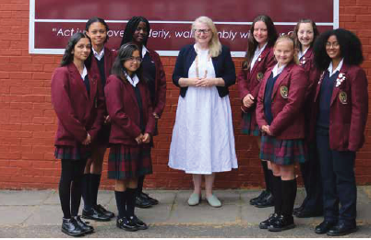
Making your application
Provide supporting information with your application if you are asking for medical priority. Few places are granted on these grounds.
  Complete any supplementary forms and send them directly to the schools
  Meet all the deadlines

Slide 12
Supplementary Information forms and testing
These schools require these:
Enfield Grammar – sports and music criterion only
Bishop Stopford
Kingsmead – art/drama/music (10% of places)
St. Anne's
St Ignatius College
The Latymer (already completed in June 23)
Wren Academy Enfield

Slide 13
Children with an EHCP
If a child is in the process of applying for an EHCP they should apply for secondary school in the normal way.
If your child has an EHCP- both schools and parents will be advised of a separate process lead by the SEN Service

Slide 14
Enfield parents applying out of Borough
You must include these schools on your Enfield application form.
SIF sent directly to the school is not enough, you must apply through Enfield LA system.

Slide 15

Making your application
  Make sure you tell us…
  If the child is looked
  after or adopted?
  Are there brothers or sisters attending any of the schools applied for?
  Does a parent work at any of the schools listed on your form?

Slide 16
What can Enfield parents expect?
Parents in London can list up to 6 schools. In Hertfordshire this reduces to 4.
Parents will not be able to change preferences after Oct 31st online. This can be request only in writing and before 8th November 2023
6 preferences across London (Hertfordshire will only accept four Hertfordshire schools – don’t include more)

Slide 17
Order of preference
Parents are ask to indicate their true order of preference for the schools. The secondary schools do not get this information.
If a child gets offered more than one place, the school which has been indicated as a higher preference will be offered.
Parents will not be told if their child had qualified for other schools.

Slide 18
Late applications
You will be able to make a late application from 1st Nov to Aug 24.
You will not be able to change your preferences.

Slide 19
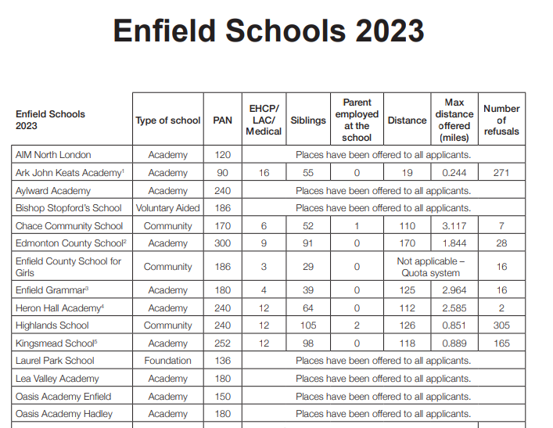
Enfield Schools - What happened this year

Slide 20
Be careful
Oasis Academy Enfield
Oasis Academy Hadley
Select the correct school in the drop down menu

Slide 21

Things to remember
Make an informed decision. Consider first
  hand, accurate and up to date information
Speak to your child’s primary school
Be realistic.
Mrs Berman always on hand to support

Slide 22


